Slide 1

Course: Object Oriented and JAVA Programming
SCHOOL OF COMPUTER ENGINEERING AND TECHNOLOGY

Slide 2
Agenda
Introduction
Hierarchy of Collection Framework
Data Structures(JAVA)

Slide 3
Introduction
The Collection in Java is a framework that provides an architecture to store and manipulate the group of objects.
Java Collections can achieve all the operations that you perform on a data such as searching, sorting, insertion, manipulation, and deletion.
Java Collection means a single unit of objects.
Java Collection framework provides many interfaces (Set, List, Queue, Deque) and classes (ArrayList, Vector, LinkedList, PriorityQueue, HashSet, LinkedHashSet, TreeSet).

Slide 4
Contd..
What is Collection in Java
A Collection represents a single unit of objects, i.e., a group.
What is a framework in Java
It provides readymade architecture.
It represents a set of classes and interfaces.
It is optional.
What is Collection framework
The Collection framework represents a unified architecture for storing and manipulating a group of objects.
It has:
Interfaces and its implementations, i.e., classes
Algorithm

Slide 5
Generics
Java Generic methods and generic classes enable programmers to specify, with a single method declaration, a set of related methods, or with a single class declaration, a set of related types, respectively.
Generics also provide compile-time type safety that allows programmers to catch invalid types at compile time.
All generic method declarations have a type parameter section delimited by angle brackets (< and >) that precedes the method's return type

Slide 6
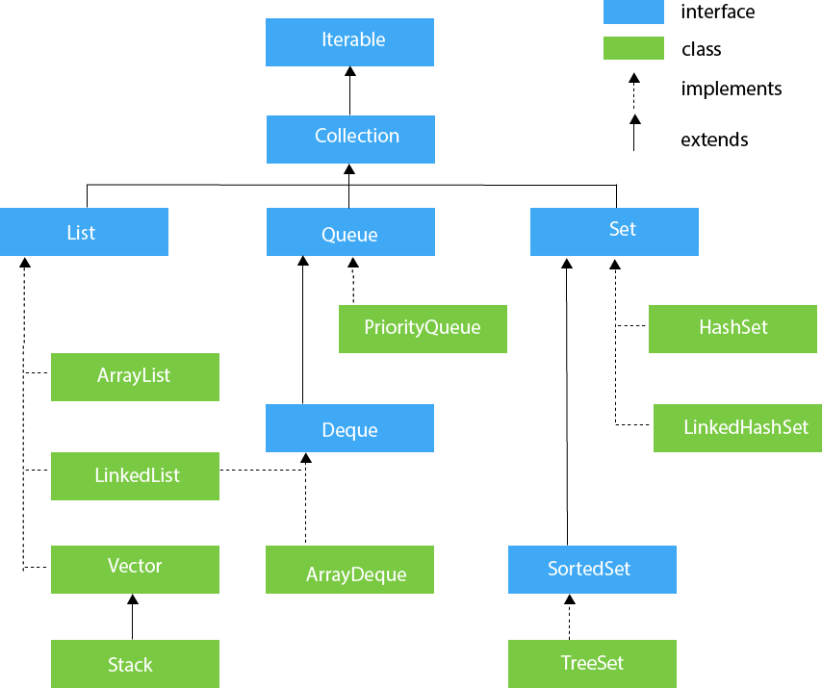
Hierarchy of Collection Framework

Slide 7
Array List
- The ArrayList class extends AbstractList and implements the List interface. - ArrayList supports dynamic arrays that can grow as needed.
Standard Java arrays are of a fixed length. - After arrays are created, they cannot grow or shrink, which means that you must know in advance how many elements an array will hold. - Array lists are created with an initial size. When this size is exceeded, the collection is automatically enlarged. -When objects are removed, the array may be shrunk.

Slide 8
Array List
ArrayList( )
This constructor builds an empty array list.
ArrayList(Collection c)
This constructor builds an array list that is initialized with the elements of the collection c.
ArrayList(int capacity)
This constructor builds an array list that has the specified initial capacity. The capacity is the size of the underlying array that is used to store the elements. The capacity grows automatically as elements are added to an array list.

Slide 9
Array List
void add(int index, Object element)
Inserts the specified element at the specified position index in this list. Throws IndexOutOfBoundsException if the specified index is out of range (index < 0 || index > size()).
boolean add(Object o)
Appends the specified element to the end of this list.
void clear()
Removes all of the elements from this list.
int indexOf(Object o)
Returns the index in this list of the first occurrence of the specified element, or -1 if the List does not contain this element.

Slide 10
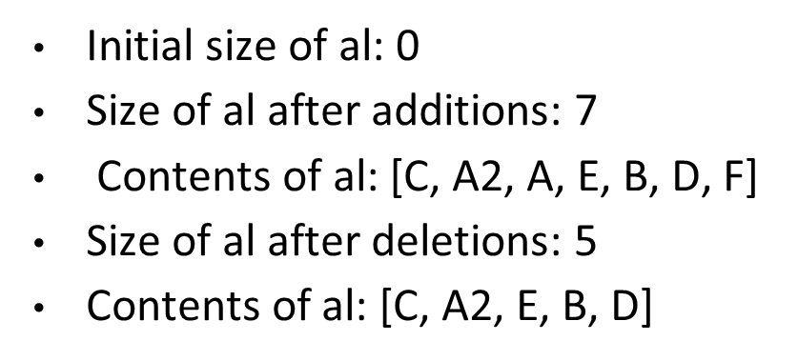
Array List Example
import java.util.*;
public class ArrayListDemo {
public static void main(String args[]) {
ArrayList al = new ArrayList(); // create an array list
System.out.println("Initial size of al: " + al.size()); // add elements
al.add("C");
al.add("A");
al.add("E");
al.add("B");
al.add("D");
al.add("F");
al.add(1, "A2");
System.out.println("Size of al after additions: " + al.size()); // display
System.out.println("Contents of al: " + al); // Remove elements
al.remove("F");
al.remove(2);
System.out.println("Size of al after deletions: " + al.size()); System.out.println("Contents of al: " + al);
} }

Slide 11
Java - Data Structures
The data structures provided by the Java utility package are very powerful and perform a wide range of functions. These data structures consist of the following interface and classes
Enumeration
BitSet
Vector
Stack
Dictionary
Hashtable
Properties
All these classes are now legacy and Java-2 has introduced a new framework called Collections Framework

Slide 12
The Enumeration
The Enumeration interface isn't itself a data structure. It defines a means to retrieve successive elements from a data structure.
For example, Enumeration defines a method called nextElement that is used to get the next element in a data structure that contains multiple elements.

Slide 13
The Enumeration contd..
The Enumeration interface defines the methods by which you can enumerate (obtain one at a time) the elements in a collection of objects.
boolean hasMoreElements( )
When implemented, it must return true while there are still more elements to extract, and false when all the elements have been enumerated.
Object nextElement( )
This returns the next object in the enumeration as a generic Object reference.

Slide 14
Example of Vector
import java.util.Vector;
import java.util.Enumeration;
public class EnumerationTester {
public static void main(String args[]) {
Enumeration days;
Vector dayNames = new Vector(); dayNames.add("Sunday"); dayNames.add("Monday"); dayNames.add("Tuesday"); dayNames.add("Wednesday"); dayNames.add("Thursday"); dayNames.add("Friday"); dayNames.add("Saturday");
days = dayNames.elements();
while (days.hasMoreElements())
{
System.out.println(days.nextElement()); } } }
Output: Sunday Monday Tuesday Wednesday Thursday Friday Saturday

Slide 15
The Vector
The Vector class is similar to a traditional Java array, except that it can grow as necessary to accommodate new elements.
Like an array, elements of a Vector object can be accessed via an index into the vector.
The nice thing about using the Vector class is that you don't have to worry about setting it to a specific size upon creation; it shrinks and grows automatically when necessary.

Slide 16
Example of Vector
import java.util.*;
public class VectorDemo {
public static void main(String args[]) { // initial size is 3, increment is 2 Vector
v = new Vector(3, 2);
System.out.println("Initial size: " + v.size());
System.out.println("Initial capacity: " + v.capacity());
v.addElement(new Integer(1));
v.addElement(new Integer(2));
v.addElement(new Integer(3));
v.addElement(new Integer(4));
System.out.println("Capacity after four additions: " + v.capacity()); v.addElement(new Double(5.45));
System.out.println("Current capacity: " + v.capacity());
v.addElement(new Double(6.08));
v.addElement(new Integer(7));
System.out.println("Current capacity: " + v.capacity());
v.addElement(new Float(9.4));
v.addElement(new Integer(10));

Slide 17
System.out.println("Current capacity: " + v.capacity());
v.addElement(new Integer(11));
v.addElement(new Integer(12));
System.out.println("First element: " + (Integer)v.firstElement());
System.out.println("Last element: " + (Integer)v.lastElement());
if(v.contains(new Integer(3)))
System.out.println("Vector contains 3."); // enumerate the elements in the vector.
Enumeration vEnum = v.elements();
System.out.println("\nElements in vector:");
while(vEnum.hasMoreElements())
System.out.print(vEnum.nextElement() + " ");
System.out.println(); }
}

Slide 18
output
Initial size: 0 Initial capacity: 3
Capacity after four additions: 5
Current capacity: 5
Current capacity: 7
Current capacity: 9
First element: 1
Last element: 12
Vector contains 3.
Elements in vector: 1 2 3 4 5.45 6.08 7 9.4 10 11 12

Slide 19
The Stack
The Stack class implements a last-in-first-out (LIFO) stack of elements.
You can think of a stack literally as a vertical stack of objects; when you add a new element, it gets stacked on top of the others.
When you pull an element off the stack, it comes off the top. In other words, the last element you added to the stack is the first one to come back off.

Slide 20
boolean empty()
Tests if this stack is empty. Returns true if the stack is empty, and returns false if the stack contains elements.
Object peek( )
Returns the element on the top of the stack, but does not remove it.
Object pop( )
Returns the element on the top of the stack, removing it in the process.
Object push(Object element)
Pushes the element onto the stack. Element is also returned.
int search(Object element)
Searches for element in the stack. If found, its offset from the top of the stack is returned. Otherwise, -1 is returned.

Slide 21
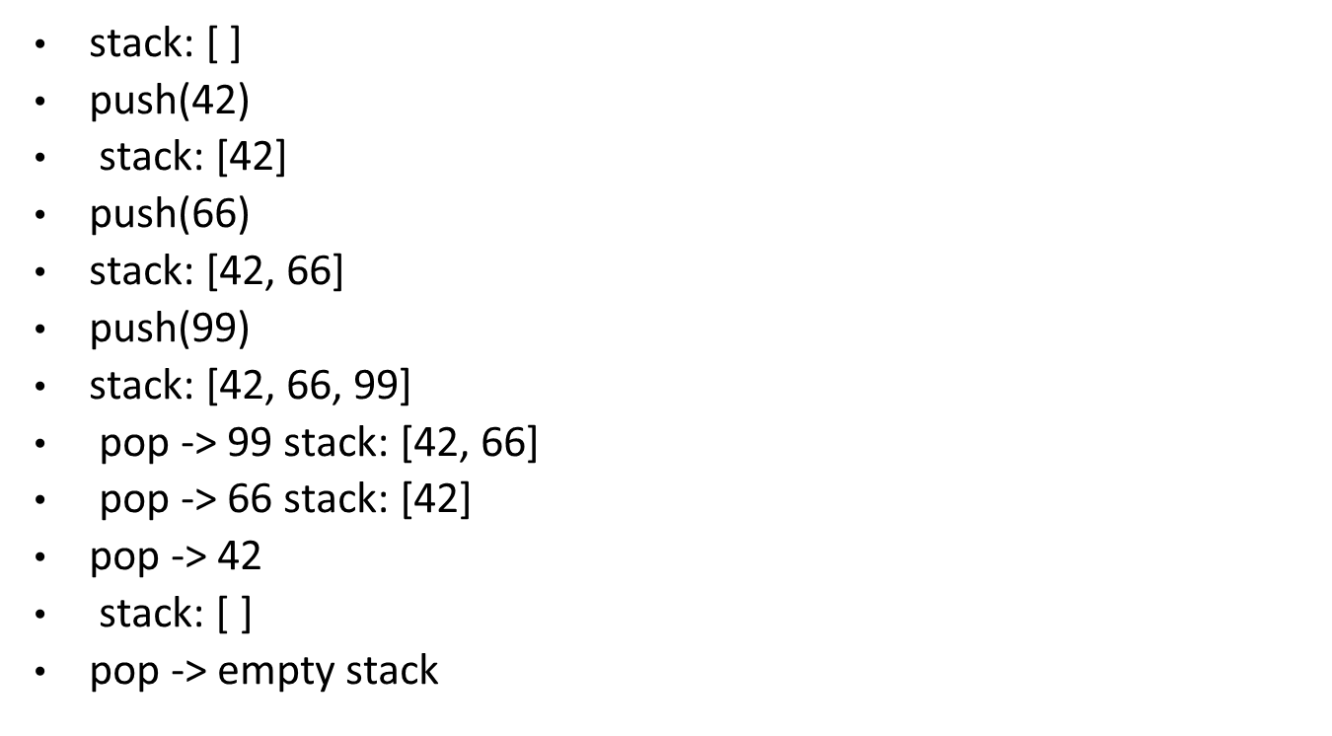
Example of Stack
import java.util.*;
public class StackDemo {
static void showpush(Stack st, int a) {
st.push(new Integer(a));
System.out.println("push(" + a + ")");
System.out.println("stack: " + st); }
static void showpop(Stack st) {
System.out.print("pop -> ");
Integer a = (Integer) st.pop();
System.out.println(a);
System.out.println("stack: " + st); }
public static void main(String args[]){
Stack st = new Stack();
System.out.println("stack: " + st);
showpush(st, 42); showpush(st, 66); showpush(st, 99);
showpop(st); showpop(st); showpop(st);
try
{ showpop(st); }
catch (EmptyStackException e)
{ System.out.println("empty stack");
} } }

Slide 22
The Dictionary
The Dictionary class is an abstract class that defines a data structure for mapping keys to values.
This is useful in cases where you want to be able to access data via a particular key rather than an integer index.
Since the Dictionary class is abstract, it provides only the framework for a key-mapped data structure rather than a specific implementation.

Slide 23
Enumeration elements( )
Returns an enumeration of the values contained in the dictionary.
Object get(Object key)
Returns the object that contains the value associated with the key. If the key is not in the dictionary, a null object is returned.
boolean isEmpty( )
Returns true if the dictionary is empty, and returns false if it contains at least one key.
Enumeration keys( )
Returns an enumeration of the keys contained in the dictionary.
Object put(Object key, Object value)
Inserts a key and its value into the dictionary. Returns null if the key is not already in the dictionary; returns the previous value associated with the key if the key is already in the dictionary.
Object remove(Object key)
Removes the key and its value. Returns the value associated with the key. If the key is not in the dictionary, a null is returned.
int size( )
Returns the number of entries in the dictionary.

Slide 24
The Dictionary class is obsolete. You should implement the Map interface to obtain key/value storage functionality.
The Map interface maps unique keys to values. A key is an object that you use to retrieve a value at a later date.
Given a key and a value, you can store the value in a Map object. After the value is stored, you can retrieve it by using its key.

Slide 25
void clear( ):Removes all key/value pairs from the invoking map.
boolean containsKey(Object k):Returns true if the invoking map contains k as a key. Otherwise, returns false.
boolean containsValue(Object v):Returns true if the map contains v as a value. Otherwise, returns false.
Set entrySet( ):Returns a Set that contains the entries in the map. The set contains objects of type Map.Entry. This method provides a set-view of the invoking map.
boolean equals(Object obj):Returns true if obj is a Map and contains the same entries. Otherwise, returns false.
Object get(Object k):Returns the value associated with the key k.
int hashCode( ):Returns the hash code for the invoking map.
boolean isEmpty( ):Returns true if the invoking map is empty. Otherwise, returns false.

Slide 26
Set keySet( ):Returns a Set that contains the keys in the invoking map. This method provides a set-view of the keys in the invoking map.
Object put(Object k, Object v):Puts an entry in the invoking map, overwriting any previous value associated with the key. The key and value are k and v, respectively. Returns null if the key did not already exist. Otherwise, the previous value linked to the key is returned.
void putAll(Map m):Puts all the entries from m into this map.
Object remove(Object k):Removes the entry whose key equals k.
int size( ):Returns the number of key/value pairs in the map.
Collection values( ):Returns a collection containing the values in the map. This method provides a collection-view of the values in the map.

Slide 27
Example
import java.util.*;
public class CollectionsDemo {
public static void main(String[] args) {
Map m1 = new HashMap();
m1.put("Zara", "8");
m1.put("Mahnaz", "31");
m1.put("Ayan", "12");
m1.put("Daisy", "14");
System.out.println();
System.out.println(" Map Elements");
System.out.print("\t" + m1); }
}
Output:-
Map Elements {Daisy = 14, Ayan = 12, Zara = 8, Mahnaz = 31}

Slide 28
The Hashtable
The Hashtable class provides a means of organizing data based on some user-defined key structure.
For example, in an address list hash table you could store and sort data based on a key such as ZIP code rather than on a person's name.
The specific meaning of keys with regard to hash tables is totally dependent on the usage of the hash table and the data it contains.

Slide 29
Example of Hash Map
import java.util.*;
public class HashTableDemo {
public static void main(String args[])
{ // Create a hash map
Hashtable balance = new Hashtable();
Enumeration names; String str; double bal;
balance.put("Zara", new Double(3434.34));
balance.put("Mahnaz", new Double(123.22));
balance.put("Ayan", new Double(1378.00));
balance.put("Daisy", new Double(99.22));
balance.put("Qadir", new Double(-19.08)); // Show all balances in hash table.
names = balance.keys();
while(names.hasMoreElements()) {
str = (String) names.nextElement();
System.out.println(str + ": " + balance.get(str)); }
System.out.println();
// Deposit 1,000 into Zara's account
bal = ((Double)balance.get("Zara")).doubleValue();
balance.put("Zara", new Double(bal + 1000));
System.out.println("Zara's new balance: " + balance.get("Zara")); }
}
OUTPUT:Qadir: -19.08 Zara: 3434.34 Mahnaz: 123.22 Daisy: 99.22 Ayan: 1378.0 Zara's new balance: 4434.34

Slide 30
Interfaces (Set, List, Queue, and Dequeue)
A Set is a Collection that cannot contain duplicate elements. It models the mathematical set abstraction.
The Set interface contains only methods inherited from Collection and adds the restriction that duplicate elements are prohibited.
Set also adds a stronger contract on the behavior of the equals and hashCode operations, allowing Set instances to be compared meaningfully even if their implementation types differ.

Slide 31
add( )
Adds an object to the collection.
clear( )
Removes all objects from the collection.
contains( )
Returns true if a specified object is an element within the collection.
isEmpty( )
Returns true if the collection has no elements.
iterator( )
Returns an Iterator object for the collection, which may be used to retrieve an object.
remove( )
Removes a specified object from the collection.
size( )
Returns the number of elements in the collection.

Slide 32
import java.util.*;
public class SetDemo {
public static void main(String args[])
{
int count[] = {34, 22,10,60,30,22};
Set<Integer> set = new HashSet<Integer>();
try
{ for(int i = 0; i < 5; i++)
{
set.add(count[i]); }
System.out.println(set);
TreeSet sortedSet = new TreeSet<Integer>(set); System.out.println("The sorted list is:"); System.out.println(sortedSet);
System.out.println("The First element of the set is: "+ (Integer)sortedSet.first());
System.out.println("The last element of the set is: "+ (Integer)sortedSet.last()); }
catch(Exception e) {} } }

Slide 33
Output
[34, 22, 10, 60, 30]
The sorted list is: [10, 22, 30, 34, 60]
The First element of the set is: 10
The last element of the set is: 60

Slide 34
Java LinkedList class
Java LinkedList class uses doubly linked list to store the elements. It provides a linked-list data structure. It inherits the AbstractList class and implements List and Deque interfaces.
The important points about Java LinkedList are:
Java LinkedList class can contain duplicate elements.
Java LinkedList class maintains insertion order.
Java LinkedList class is non synchronized.
In Java LinkedList class, manipulation is fast because no shifting needs to be occurred.
Java LinkedList class can be used as list, stack or queue.

Slide 35
Methods of Linked List
LinkedList()It is used to construct an empty list.
LinkedList(Collection c): It is used to construct a list containing the elements of the specified collection, in the order they are returned by the collection's iterator.Methods of Java LinkedList
void add(int index, Object element):It is used to insert the specified element at the specified position index in a list.void addFirst(Object o)It is used to insert the given element at the beginning of a list.
void addLast(Object o)It is used to append the given element to the end of a list.int size()It is used to return the number of elements in a listboolean add(Object o)It is used to append the specified element to the end of a list.
boolean contains(Object o):It is used to return true if the list contains a specified element.

Slide 36
boolean remove(Object o):It is used to remove the first occurence of the specified element in a list.
Object getFirst():It is used to return the first element in a list.
Object getLast():It is used to return the last element in a list.
int indexOf(Object o):It is used to return the index in a list of the first occurrence of the specified element, or -1 if the list does not contain any element.
int lastIndexOf(Object o):It is used to return the index in a list of the last occurrence of the specified element, or -1 if the list does not contain any element.

Slide 37
Example of Linked List
import java.util.*;
public class TestCollection7{
public static void main(String args[])
{
LinkedList<String> al=new LinkedList<String>();
al.add("Ravi");
al.add("Vijay");
al.add("Ravi");
al.add("Ajay");
Iterator<String> itr=al.iterator();
while(itr.hasNext()){
System.out.println(itr.next());
}
}
}
Output:Ravi Vijay Ravi Ajay

Slide 38
Difference between ArrayList and LinkedList
Array List and LinkedList both implements List interface and maintains insertion order. Both are non synchronized classes.
ArrayList vs LinkedList
1) ArrayList internally uses dynamic array to store the elements. LinkedList internally uses doubly linked list to store the elements.
2) Manipulation with ArrayList is slow because it internally uses array. If any element is removed from the array, all the bits are shifted in memory.
Manipulation with LinkedList is faster than ArrayList because it uses doubly linked list so no bit shifting is required in memory.
3) ArrayList class can act as a list only because it implements List only.
LinkedList class can act as a list and queue both because it implements List and Deque interfaces.
4) ArrayList is better for storing and accessing data.
LinkedList is better for manipulatingdata.

Slide 39
void add(int index,Object element):It is used to insert element into the invoking list at the index passed in the index.
boolean addAll(int index,Collection c):It is used to insert all elements of c into the invoking list at the index passed in the index.
object get(int index)
It is used to return the object stored at the specified index within the invoking collection.
object set(int index,Object element)
It is used to assign element to the location specified by index within the invoking list.
object remove(int index)It is used to remove the element at position index from the invoking list and return the deleted element.
ListIterator listIterator()It is used to return an iterator to the start of the invoking list.ListIterator
listIterator(int index)It is used to return an iterator to the invoking list that begins at the specified index.

Slide 40
Example of Linked List
import java.util.*;
class TestArrayLinked{
public static void main(String args[])
{
List<String> al=new ArrayList<String>();//creating arraylist
al.add("Ravi");//adding object in arraylist
al.add("Vijay");
al.add("Ravi");
al.add("Ajay");
List<String> al2=new LinkedList<String>();//creating linkedlist
al2.add("James");//adding object in linkedlist
al2.add("Serena");
al2.add("Swati");
al2.add("Junaid");
System.out.println("arraylist: "+al);
System.out.println("linkedlist: "+al2);
}
}

Slide 41
Output
arraylist: [Ravi,Vijay,Ravi,Ajay]
linkedlist: [James,Serena,Swati,Junaid]

Slide 42
Classes (ArrayList, Vector, LinkedList, PriorityQueue, HashSet, LinkedHashSet, and TreeSet).
Java Queue Interface
Java Queue interface orders the element in FIFO(First In First Out) manner. In FIFO, first element is removed first and last element is removed at last.
Queue Interface declaration
public interface Queue<E> extends Collection<E>

Slide 43
Queue Methods
boolean add(object):It is used to insert the specified element into this queue and return true upon success.
boolean offer(object):It is used to insert the specified element into this queue.
Object remove():It is used to retrieves and removes the head of this queue.
Object poll():It is used to retrieves and removes the head of this queue, or returns null if this queue is empty.
Object element():It is used to retrieves, but does not remove, the head of this queue.
Object peek():It is used to retrieves, but does not remove, the head of this queue, or returns null if this queue is empty.

Slide 44
PriorityQueue class
The PriorityQueue class provides the facility of using queue. But it does not orders the elements in FIFO manner. It inherits AbstractQueue class.
PriorityQueue class declaration
The declaration for java.util.PriorityQueue class.
public class PriorityQueue<E> extends AbstractQueue<E> implements Serializable

Slide 45
import java.util.*;
class TestCollection12{
public static void main(String args[])
{
PriorityQueue<String> queue=new PriorityQueue<String>();
queue.add("Amit");
queue.add("Vijay");
queue.add("Karan");
queue.add("Jai");
queue.add("Rahul");
System.out.println("head:"+queue.element());
System.out.println("head:"+queue.peek());
System.out.println("iterating the queue elements:");
Iterator itr=queue.iterator();
while(itr.hasNext())
{
System.out.println(itr.next());
}
queue.remove();
queue.poll();
System.out.println("after removing two elements:");
Iterator<String> itr2=queue.iterator();
while(itr2.hasNext()){
System.out.println(itr2.next());
}
}
}

Slide 46
Output
head:Amit
head:Amit
iterating the queue elements: Amit Jai Karan Vijay Rahul
after removing two elements: Karan Rahul Vijay

Slide 47
Thank You!!

